Slide 1
CIS 4517/5517: Data Intensive and Cloud Computing Big Data Analytics
Dr. Xubin He
Computer and Information Sciences
Temple University

Slide 2
Outline
Review last class: PageRank
Recommendation system
Big data analytics
Acknowledgement: We thank Andrew Schwartz of Stonybrook for sharing some of the original slides on Big Data.

Slide 3
PageRank
A method for rating the importance of web pages objectively and mechanically using the link structure of the web.
Page, Lawrence and Brin, Sergey and Motwani, Rajeev and Winograd, Terry, The PageRank Citation Ranking: Bringing Order to the Web, http://ilpubs.stanford.edu:8090/422/

Slide 4
Web page graph
Web pages are organized in a network.
Each webpage is represented as a node.
Each hyperlink is a directed edge
The entire web can be viewed as a directed graph.

Slide 5
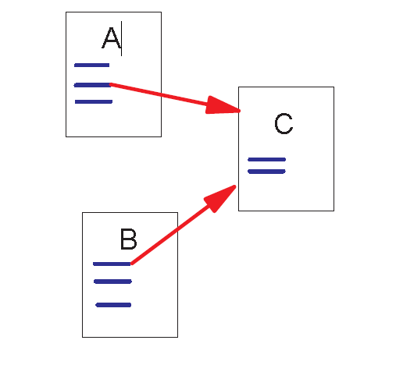
Link Structure of the Web
Backlinks and Forward links:
A and B are C’s backlinks
C is A and B’s forward link
Intuitively, a webpage is important if it has a lot of backlinks.

Slide 6
PageRank
Simply counting the backlinks of a web page is not good enough to rank the quality of a page, we should consider both cases when a page has many backlinks and when a page has a few highly ranked backlinks.
PageRank:
A page has high rank if the sum of the ranks of its backlinks is high.

Slide 7
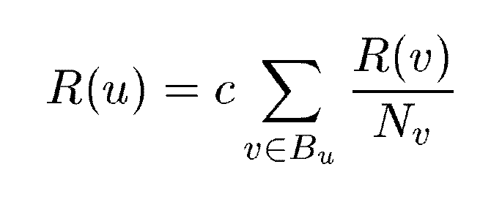
A Simple Version of PageRank
u: a web page
B_{u}: the set of u’s backlinks
N_{v}: the number of forward links of page v
c: the normalization factor so that the total rank of all web pages is constant.

Slide 8
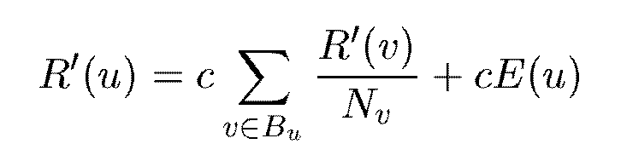
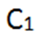
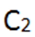
Modified version of PageRank :
E(u): a distribution of ranks of web pages that “users” jump to
when they “gets bored” after successive links at random.
Typically, C₁+C₂=1, then we can rewrite for easy understanding for a specific web page A, its page rank PR(A) can be calculated as (C1=d, C2=1-d, E(u)=1):
PR(A) = (1-d) + d (PR(T₁) / C(T₁) + ….. + PR(T_{n}) / C(T_{n}) )
d: damping factor

Slide 9
PageRank Example
Initially:
PR(A)=1
PR(B)=1
PR(C)=1
A
C
B
Calculate the PR values of A, B, C using the simple (assume c=1) and modified PageRank (assume d=0.8) algorithms. Show the first two iterations.

Slide 10
PageRank Example: simple PageRank
Initially:
PR(A)=1
PR(B)=1
PR(C)=1
A
C
B
C=1

Slide 11
PageRank Example: simple PageRank
After 1st iter:
PR(A)=1.5
PR(B)=1
PR(C)=0.5
A
C
B
C=1

Slide 12
PageRank Example: modified PageRank
Initially:
PR(A)=1
PR(B)=1
PR(C)=1
PR(A) = (1-d) + d (PR(T₁) / C(T₁) + ….. + PR(T_{n}) / C(T_{n}) )
d=0.8
A
C
B

Slide 13
Outline
Review last class: PageRank
Recommendation system
Big data analytics
Acknowledgement: We thank Andrew Schwartz of Stonybrook for sharing some of the original slides on Big Data.

Slide 14
Recommendation Systems
Advertising on traditional medias
Can’t be customized to each user; many ad showings do not reach intended targets
Big data on user behaviors tell what a user may like
Allow online, targeted advertising
Broaden the ad market (low‐interest items are appropriate targets now)
Make online advertising much more effective => for the first time allow very large businesses to thrive on advertising alone

Slide 15
Applications
Search ads
Product recommendations at online retailers
Movie recommendations
YouTube suggestions
Recommendations for news articles, blogs
… …

Slide 16
Methods for Recommendation
Identify user/item profiles and match them for recommendation
Content‐based recommendation
Link similar users and identify preferred items by similar users as recommendation
Collaborative filtering

Slide 17
Content‐Based Recommendation
Identify user/item profiles and match them for recommendation
Search ads
Item profiles are categories and keywords for ads
User profiles are the keywords user provided for search

Slide 18
Obtain Item Features from Tags
Too little descriptive information: images
Tagging
How to tag images?
Computer vision
ImageNet: (https://www.historyofdatascience.com/imagenet-a-pioneering-vision-for-computers/), the ImageNet database now contains more than 14 million annotated images.
Mapreduce?
ImageNet to ChatGPT: https://www.youtube.com/watch?v=upYWPko6hvA
Web crawling and mining

Slide 19
Obtain User Profiles
Probably the most valuable data are those that contain user activities or behaviors
Direct: search keywords, filing out profiles/surveys
Indirect inference:
blogposts, tweets
browsing history (offer free content to attract users, infer their profiles, and show targeted recommendation)
offer free entertainment (games) to attract users, …

Slide 20
Collaborative Filtering
Find similar users for a given target user and identify preferred items by similar users as recommendation
Clustering users

Slide 21
The NetFlix Challenge
Movie recommendation, from the labs, winning the Netflix prize.
AT&T Labs researchers and million dollar Netflix Prize co-winners, Chris Volinsky and Robert Bell, describe their three-year quest to improve the collaborative filtering algorithm Netflix relies on to make millions of movie recommendations.
https://www.youtube.com/watch?v=ImpV70uLxyw

Slide 22
Offline/online Recommendation
Offline recommendation
Have data about items and users
Identify recommendations and mail them out
Online recommendation
Have data about items and past users
For a new user with a bit of usage data, identify recommendation quickly and show on screen/online

Slide 23
Outline
Review last class: PageRank
Recommendation system
Big data analytics
Acknowledgement: We thank Andrew Schwartz of Stonybrook for sharing some of the original slides on Big Data.

Slide 24
What is Big Data?

Slide 25



What is Big Data?
data that will not fit in main memory.
traditional computer science

Slide 26
What is Big Data?
data that will not fit in main memory.
traditional computer science
For example…
busy web server access logs
graph of the entire Web
all of Wikipedia
daily satellite imagery over a year

Slide 27
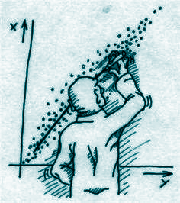



What is Big Data?
data that will not fit in main memory.
traditional computer science
data with a large number of observations and/or features.
statistics
non-traditional sample size (i.e. > 300 subjects); can’t analyze in stats tools (Excel).
other fields

Slide 28
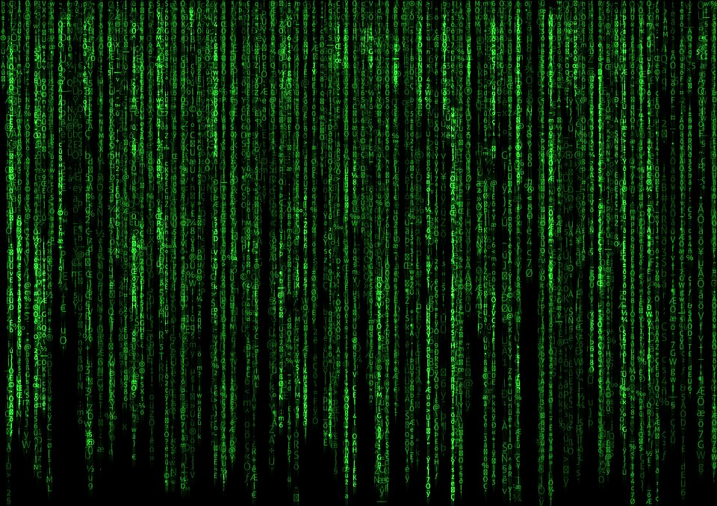

What is Big Data?
Tall data:
edge list of a large graph rgb values per pixel location in large images
data with a large number of observations and/or features.
statistics
Wide data: mobile app usage statistics of 100 people

Slide 29
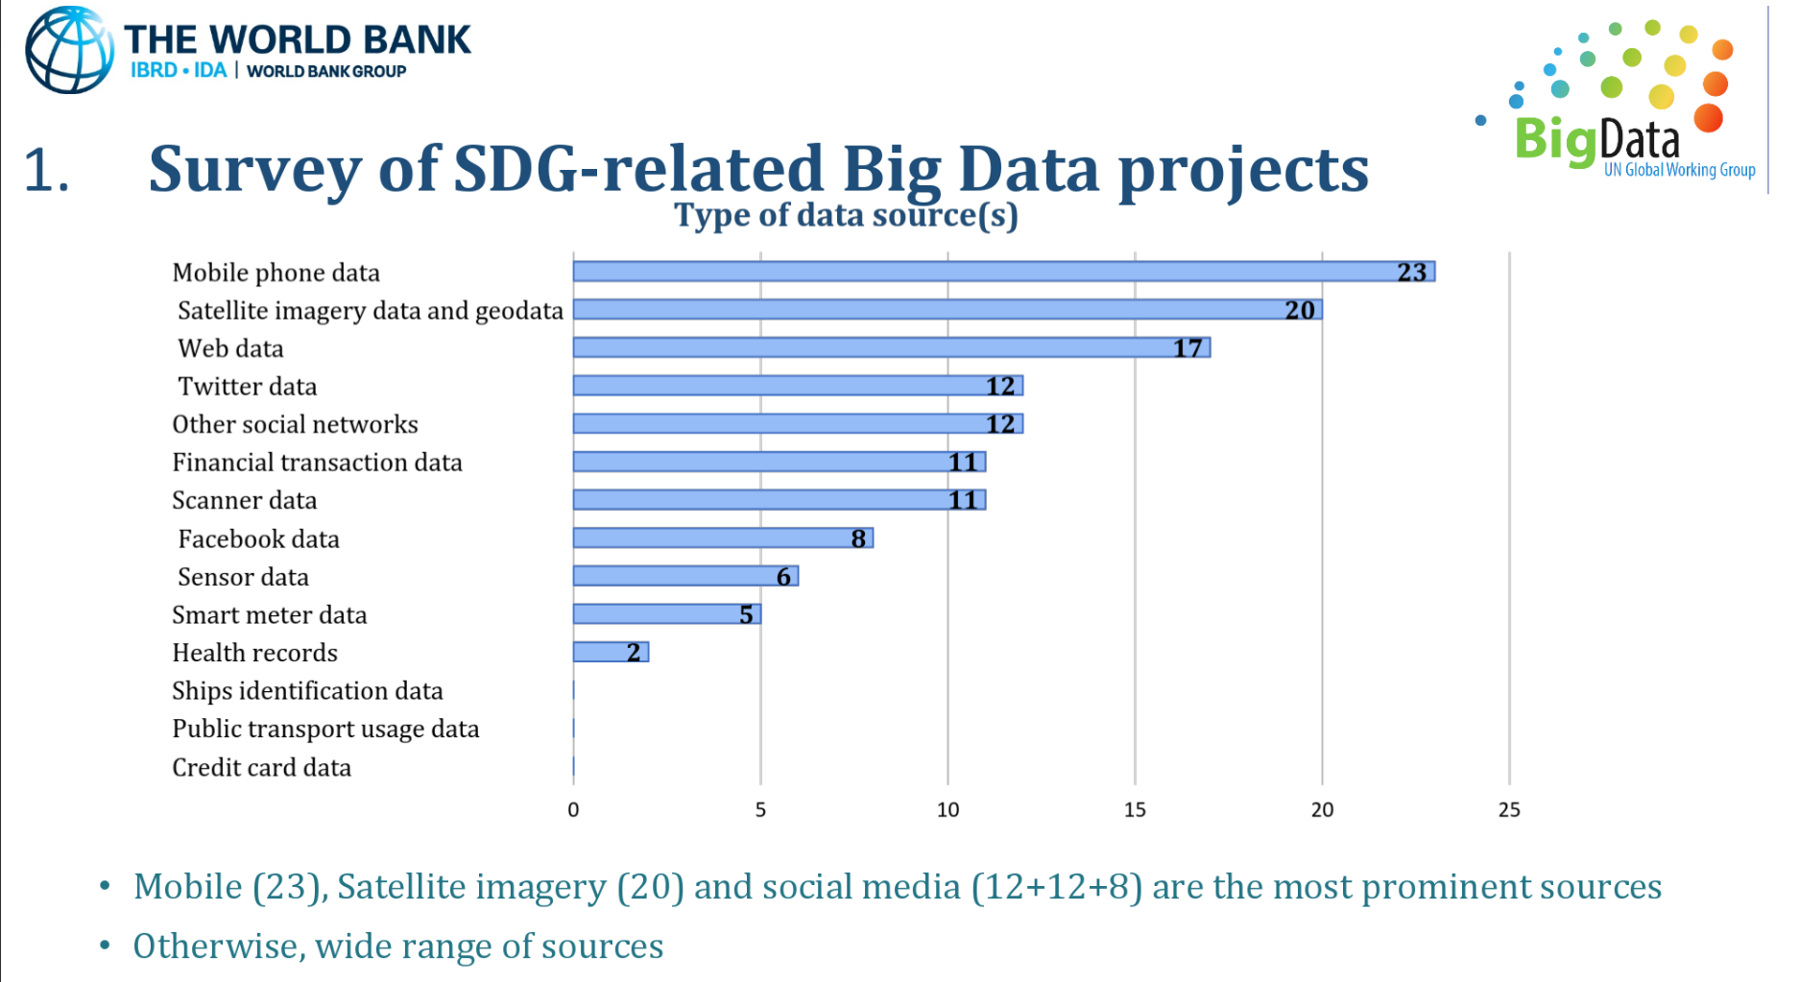
Sources of big data: Government View
(2016)
Notes:
UN Sustainable Development Goals

Slide 30
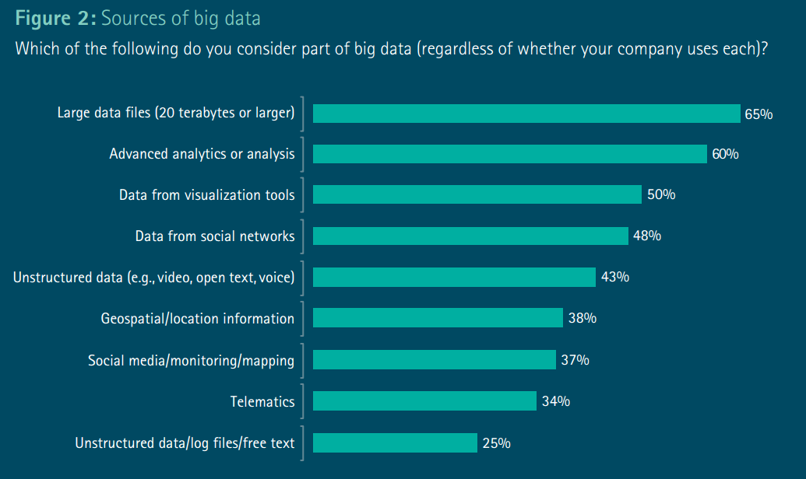
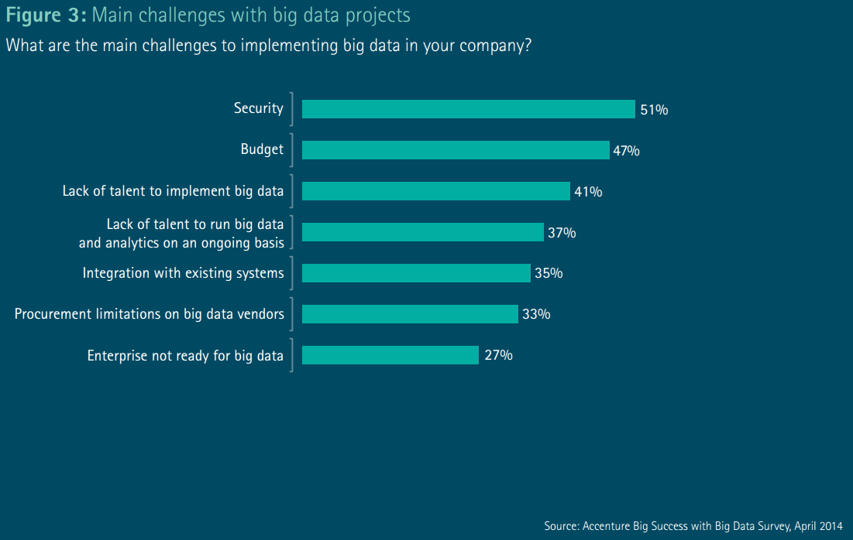
Sources of big data: Industry View

Slide 31
Big Data: definition
A huge volume of various data that is challenging to be stored or processed by any traditional data storage or processing units. Big Data is generated at a very large scale at very fast speed and it is being used by many multinational companies to process and analyse in order to uncover insights/Value and improve the business of many organizations.
Key features: five Vs
Volume: huge amount of data
Variety: different types
Veracity: uncertainty, quality and accuracy is less controllable
Velocity: speed of the data generated
Value: take advantage of the huge data
Source: https://www.edureka.co/blog/big-data-characteristics/

Slide 32
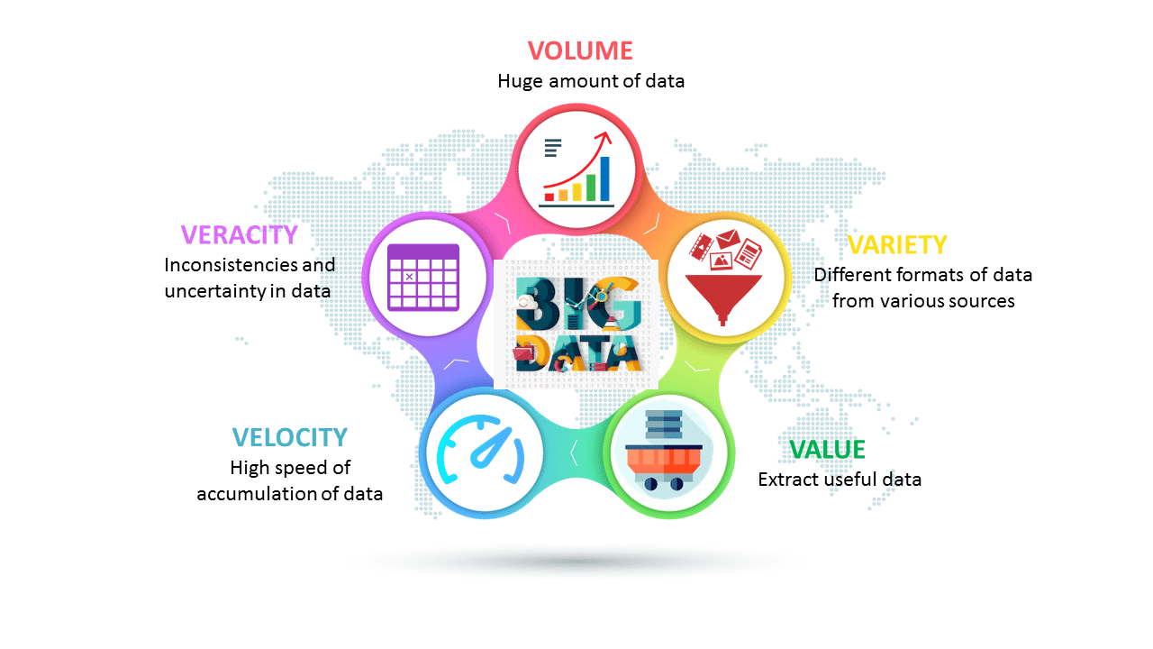
Big data characteristics: 5 Vs
Source: https://www.edureka.co/blog/big-data-characteristics/

Slide 33

Types of big data
Structured Data: owns a dedicated data model with a well-defined structure for easy access. Example: Database Management Systems such as SQL.
Unstructured Data: neither has a structure nor obeys to follow the formal structural rules of data models. It does not even have a consistent format and it found to be varying all the time. Example: Audio Files, Images etc
Semi-Structured Data: Something between structured and unstructured data. It inherits a few properties of Structured Data, but the major part of this kind of data fails to have a defined structure and it does not obey the formal structure of data models such as an RDBMS. Example: Comma Separated Values(CSV) File.
Source: https://www.edureka.co/blog/big-data-characteristics/

Slide 34
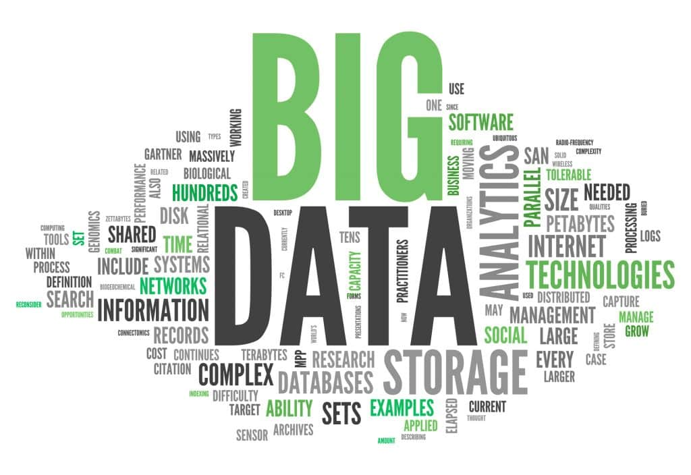
Big Data, a buzz word?
Source: https://www.edureka.co/blog/big-data-characteristics/

Slide 35
Big Data, in demand?
Notes:
Surveyed over 1000 executive of companies that had completed a big data project.

Slide 36
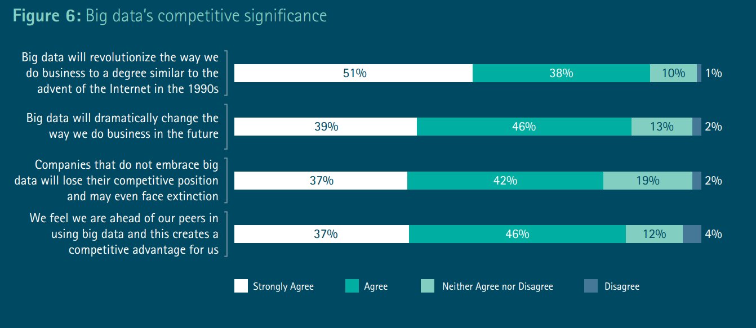
Big Data, in demand?

Slide 37
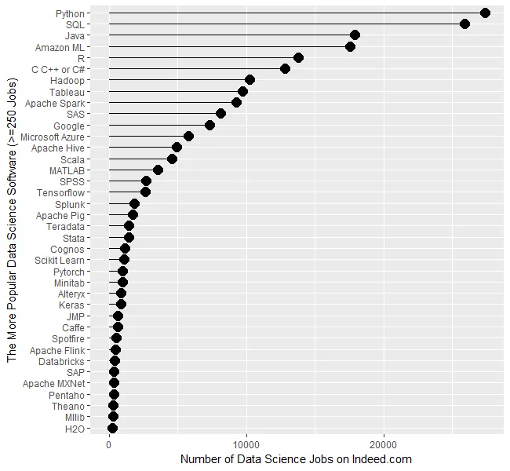
Big Data, in demand?
By the requirements in job ads. (Muenchen,2019)

Slide 38
Big Data, in demand?
By the requirements in job ads. (Muenchen,2019)
Primarily for big data Used extensively in big data

Slide 39
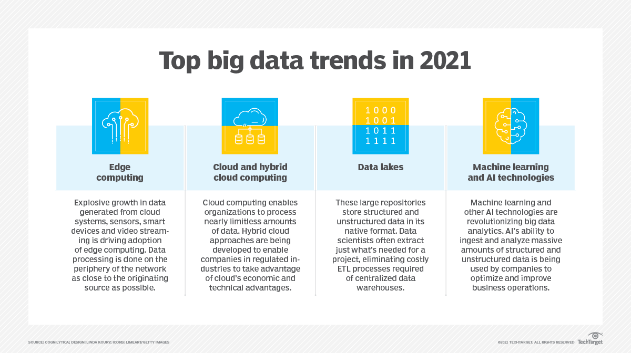
Big data trends
Notes:
ETL: extract, transform and load

Slide 40

Big Data Analytics

Slide 41
Big Data, a type of analytics
Data
Insights!

Slide 42
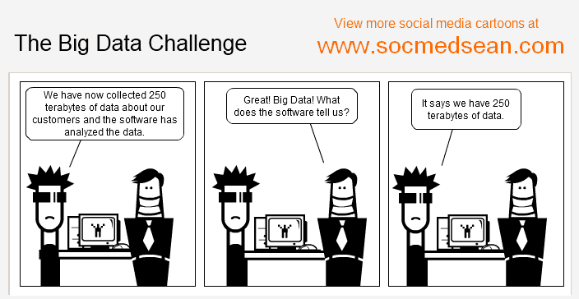
Big Data, a type of analytics

Slide 43
Big data analytics
Short Answer:
Big Data ≈ Data Mining ≈ Predictive Analytics ≈ Data Science (Leskovec et al., 2017)

Slide 44
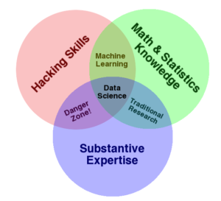
Big Data Analytics
Short Answer:
Big Data ≈ Data Mining ≈ Predictive Analytics ≈ Data Science (Leskovec et al., 2017)
(Conway, 2020)

Slide 45
Big Data Analytics
Short Answer:
Big Data ≈ Data Mining ≈ Predictive Analytics ≈ Data Science (Leskovec et al., 2017)
Computation
Statistics
Science

Slide 46
Big data Analytics
Goal: Generalizations
A model or summarization of the data.
How to analyze data that is mostly too large for main memory.
Analyses only possible with a large number of observations or features.

Slide 47
Big data Analytics
Goal: Generalizations
A model or summarization of the data.
E.g.
Google’s PageRank: summarizes web pages by a single number.
Twitter financial market predictions: Models the stock market according to shifts in sentiment in Twitter.
Distinguish tissue type in medical images: Summarizes millions of pixels into clusters.
Mental health diagnosis in social media: Models presence of diagnosis as a distribution (a summary) of linguistic patterns.
Frequent co-occurring purchases: Summarize billions of purchases as items that frequently are bought together.

Slide 48
Big data Analytics
Goal: Generalizations
A model or summarization of the data.
1. Descriptive analytics Describe (generalizes) the data itself
2. Predictive analytics Create something generalizeable to new data

Slide 49
Big Data Analytics
Goal: Generalizations
A model or summarization of the data.
Data/Workflow Frameworks
Analyses and Algorithms

Slide 50
Big Data Analytics,
Goal: Generalizations
A model or summarization of the data.
Data/Workflow Frameworks
Analyses and Algorithms
Hadoop File System
Spark
Streaming
MapReduce
Tensorflow

Slide 51
Big Data Analytics
Goal: Generalizations
A model or summarization of the data.
Data/Workflow Frameworks
Analyses and Algorithms
Similarity Search
Hadoop File System
Spark
Hypothesis Testing
Streaming
Graph Analysis
MapReduce
Recommendation Systems
Tensorflow
Deep Learning

Slide 52
Big data analytics: Preliminaries
Many ideas and methods:
Normalization (TF.IDF)
Power Laws
Hash functions
IO Boundedness (Secondary Storage)
Unstructured Data
Probability Theory
Bonferroni's Principle
Notes:
Term frequency and inverse document frequency

Slide 53
Normalization
Count data often need normalizing -- putting the numbers on the same “scale”.
Prototypical example: TF.IDF
Term Frequency (TF) and Inverse Document Frequency (IDF)

Slide 54
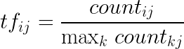
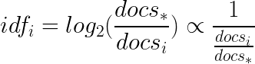
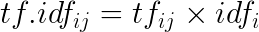
Normalization
Count data often need normalizing -- putting the numbers on the same “scale”.
Prototypical example: TF.IDF of word i in document j:
Term Frequency: Inverse Document Frequency:
where docs is the number of documents containing word i.
Notes:
Proportional

Slide 55
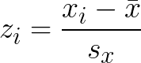
Normalization
Standardize: puts different sets of data (typically vectors or random variables) on the same scale with the same center.
Subtract the mean (i.e. “mean center”)
Divide by standard deviation

Slide 56
Power Law
Characterized many frequency patterns when ordered from most to least:
County Populations [r-bloggers.com]
# links into webpages [Broader et al., 2000]
Frequency of words [Wikipedia, “Zipf’s Law”] Zipf's law is an empirical law that often holds, approximately, when a list of measured values is sorted in decreasing order. It states that the value of the nth entry is inversely proportional to n.
Source: https://en.wikipedia.org/wiki/Zipf%27s_law

Slide 57
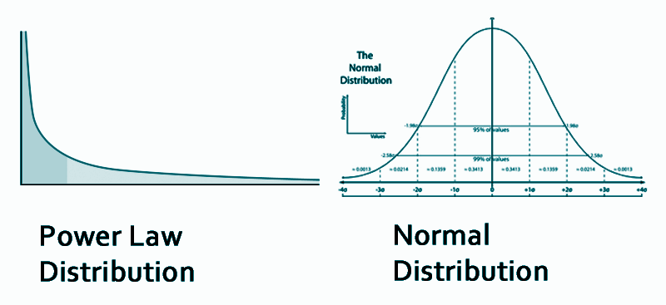
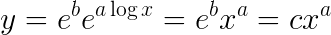
Power Law
density: proportion of observations in range
raising to the natural log:
where c is just a constant
Characterizes “the Matthew Effect” -- the rich get richer
value of x

Slide 58
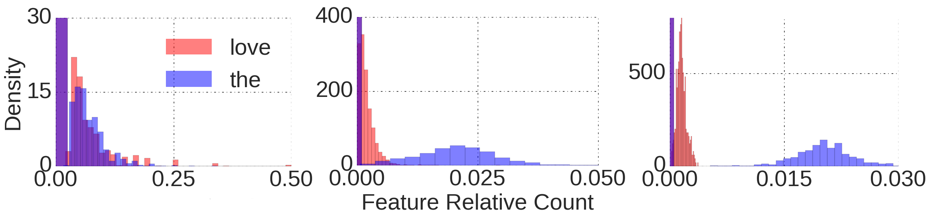
Power Law
message-level user-level county-level
Almodaresi, F., Ungar, L., Kulkarni, V., Zakeri, M., Giorgi, S., & Schwartz, H. A. (2017). On the Distribution of Lexical Features at Multiple Levels of Analysis. In Proceedings of the 55th Annual Meeting of the Association for Computational Linguistics (pp. 79-84).

Slide 59
Bonferroni's Principle
Goal: Generalizations
A model or summarization of the data.
Generalize: Find patterns that didn't just happen by chance.

Slide 60

Bonferroni's Principle; Task Example
snazzyphones.com wants to know which case to eliminate.
6 total cases:
Red
Green
Blue
Teal
Purple
Yellow

Slide 61
Bonferroni's Principle; Task Example
snazzyphones.com wants to know which case to eliminate.
6 total cases:
Red
Green
Blue
Teal
Purple
Yellow
Is a color not selling?

Slide 62
Bonferroni's Principle; Task Example
snazzyphones.com wants to know which case to eliminate.
6 total cases: first day, 17 sales:
Is a color not selling?
1
2
3
4
5
6
7
8
9
10
11
12
13
14
15
16
17
Red
Green
Blue
Teal
Purple
Yellow

Slide 63
Bonferroni's Principle; Task Example
snazzyphones.com wants to know which case to eliminate.
6 total cases: first day, 17 sales:
Is a color not selling?
How to define "not selling" so as not to make a mistake?
1
2
3
4
5
6
7
8
9
10
11
12
13
14
15
16
17
Red
Green
Blue
Teal
Purple
Yellow

Slide 64
Bonferroni's Principle; Task Example
snazzyphones.com wants to know which case to eliminate.
6 total cases: first day, 17 sales:
Is a color not selling?
How to define "not selling" so as not to make a mistake?
Counterfactual argument: Let's assume the color is as likely to sell as any other. Then what is the probability we observe this many sales?
1
2
3
4
5
6
7
8
9
10
11
12
13
14
15
16
17
Red
Green
Blue
Teal
Purple
Yellow

Slide 65
Bonferroni's Principle; Task Example
snazzyphones.com wants to know which case to eliminate.
6 total cases: first day, 17 sales:
1
2
3
4
5
6
7
8
9
10
11
12
13
14
15
16
17
Is a color not selling?
Red
Green
Blue
Teal
Purple
Yellow
Let's assume the color is as likely to sell as any other. Then what is the probability we observe this many sales?

Slide 66
Bonferroni's Principle; Task Example
snazzyphones.com wants to know which case to eliminate.
6 total cases: first day, 17 sales:
Is a color not selling?
1
2
3
4
5
6
7
8
9
10
11
12
13
14
15
16
17
Red
Green
Blue
Teal
Purple
Yellow
Let's assume the color is as likely to sell as any other. Then what is the probability we observe this many sales?
(|blue| == 0) =
??

Slide 67
Bonferroni's Principle; Task Example
snazzyphones.com wants to know which case to eliminate.
6 total cases: first day, 17 sales:
Is a color not selling?
1
2
3
4
5
6
7
8
9
10
11
12
13
14
15
16
17
Red
Green
Blue
Teal
Purple
Yellow
Let's assume the color is as likely to sell as any other. Then what is the probability we observe this many sales?
(|blue| == 0) =
(⅚)^17 = 4.5 % chance

Slide 68
Bonferroni's Principle; Task Example
snazzyphones.com wants to know which case to eliminate.
6 total cases: first day, 17 sales:
Is a color not selling?
1
2
3
4
5
6
7
8
9
10
11
12
13
14
15
16
17
Red
Green
Blue
Teal
Purple
Yellow
Let's assume the color is as likely to sell as any other. Then what is the probability we observe this many sales?
(|blue| == 0) =
(⅚)^17 = 4.5 % chance
X

Slide 69
Bonferroni's Principle; Task Example
snazzyphones.com wants to know which case to eliminate.
6 total cases: first day, 17 sales:
Is a color not selling?
1
2
3
4
5
6
7
8
9
10
11
12
13
14
15
16
17
Red
Green
Blue
Teal
Purple
Yellow
Let's assume the color is as likely to sell as any other. Then what is the probability we observe this many sales?
(|blue| == 0) =
(⅚)^17 = 4.5 % chance
p (|*| == 0) = ??
X

Slide 70
Bonferroni's Principle; Task Example
snazzyphones.com wants to know which case to eliminate.
6 total cases: first day, 17 sales:
Is a color not selling?
1
2
3
4
5
6
7
8
9
10
11
12
13
14
15
16
17
Red
Green
Blue
Teal
Purple
Yellow
Let's assume the color is as likely to sell as any other. Then what is the probability we observe this many sales?
(|blue| == 0) =
(⅚)^17 = 4.5 % chance
p (|*| == 0) = 27.0 % chance any single color doesn’t appear
X
Notes:
4.5%x6=27%

Slide 71
Bonferroni's Principle; Task Example
snazzyphones.com wants to know which case to eliminate.
6 total cases: first day, 17 sales:
Is a color not selling?
27% is roughly a 1 in 4 chance! In other words, just due to chance, we would expect 1 out of every 4 times that there are 17 sales that at least one color does not appear at all.
Would you trust eliminating a color is a "good data-informed decision" with these odds? < 5% or 1-in-20 odds is typical standard for science.
1
2
3
4
5
6
7
8
9
10
11
12
13
14
15
16
17
Let's assume the color is as likely to sell as any other. Then what is the probability we observe this many sales?
(|blue| == 0) =
(⅚)^17 = 4.5 % chance
p (|*| == 0) = 27.0 % chance any single color doesn’t appear
Red
Green
Blue
Teal
Purple
Yellow
X

Slide 72
Bonferroni's Principle; Task Example
6 total cases: first day, 17 sales:
Is a color not selling?
27% is roughly a 1 in 4 chance! In other words, just due to chance, we would expect 1 out of every 4 times that there are 17 sales that at least one color does not appear at all.
Would you trust eliminating a color is a "good data-informed decision" with these odds? < 5% or 1-in-20 odds is typical standard for science.
Let's assume the color is as likely to sell as any other. Then what is the probability we observe this many sales?
(|blue| == 0) =
(⅚)^17 = 4.5 % chance
p (|*| == 0) = 27.0 % chance any single color doesn’t appear
1
2
3
4
5
6
7
8
9
10
11
12
13
14
15
16
17
Once we look at the data and see a particular pattern, it’s easy to think in terms of chance for that specific pattern and forget one started with a broader question.
Red
Green
Blue
Teal
Purple
Yellow
X

Slide 73
Bonferroni's Principle; Task Example
6 total cases: first day, 17 sales:
Is a color not selling?
27% is roughly a 1 in 4 chance! In other words, just due to chance, we would expect 1 out of every 4 times that there are 17 sales that at least one color does not appear at all.
Would you trust eliminating a color is a "good data-informed decision" with these odds? < 5% or 1-in-20 odds is typical standard for science.
1
2
3
4
5
6
7
8
9
10
11
12
13
14
15
16
17
This is often mentioned as one of the main reasons for a so-called “replication crisis” in many sciences: In some fields, it has been suggested that over 50% of findings fail to replicate. (https://en.wikipedia.org/wiki/Replication_crisis#Tackling_publication_bias_with_pre-registration_of_studies)
Once we look at the data and see a particular pattern, it’s easy to think in terms of chance for that specific pattern and forget one started with a broader question.
Red
Green
Blue
Teal
Purple
Yellow
Let's assume the color is as likely to sell as any other. Then what is the probability we observe this many sales?
(|blue| == 0) =
(⅚)^17 = 4.5 % chance
p (|*| == 0) = 27.0 % chance any single color doesn’t appear
X

Slide 74
Bonferroni's Principle
Note: Bonferroni’s principle is simply an abstract idea inspired by a precisely defined method of hypothesis testing called “Bonferroni correction”.
Roughly, calculating the probability of any of n findings being true requires n times the probability as testing for 1 finding.
In brief, one can only look for so many patterns (i.e. features) in the data before one finds something just by chance (i.e. finding something that does not generalize).

Slide 75
The Many Faces of the Bonferroni Principle
Bonferroni's Principle
Domain | Concept | Mitigation Techniques
Machine Learning | Overfitting | Regularization; Out-of-Sample Testing (Cross-Validation)
Scientific Process | P-Hacking (data dredging) | Multi-test Correction; Hypothesis Registration
Cognitive Bias | Confirmation Bias | Awareness*: Turn to Science and Empirical Evidence.
Layman Terms | Falsely believing: "It's not just a coincidence" | Rationality*: Turn to Science and Empirical Evidence.
imprecise concepts; very effective approaches still somewhat elusive.
P-hacking: https://en.wikipedia.org/wiki/Data_dredging

Slide 76
Next
Finding similar items:
Read Chapter 3 of “Mining of Massive Datasets” at http://www.mmds.org
Quiz #4: covers lectures 9 and 10

